Slide 1
Website promotion in 10 steps
Eugene Letov

Slide 2
Why you are here
To:
promote website by yourself
manage your employee or outsourcer
know how to choose an agency

Slide 3
Why it’s so important
>50% of traffic from organic search

Slide 4
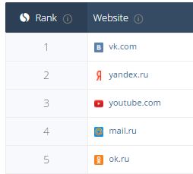
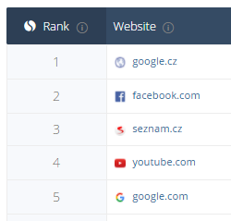
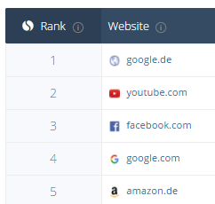
So what
similarweb.com

Slide 5
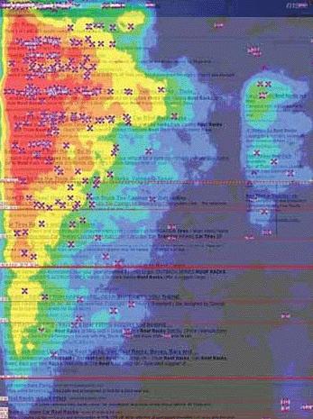
And what about business
SE users are:
very confident
very motivated
free of charge

Slide 6
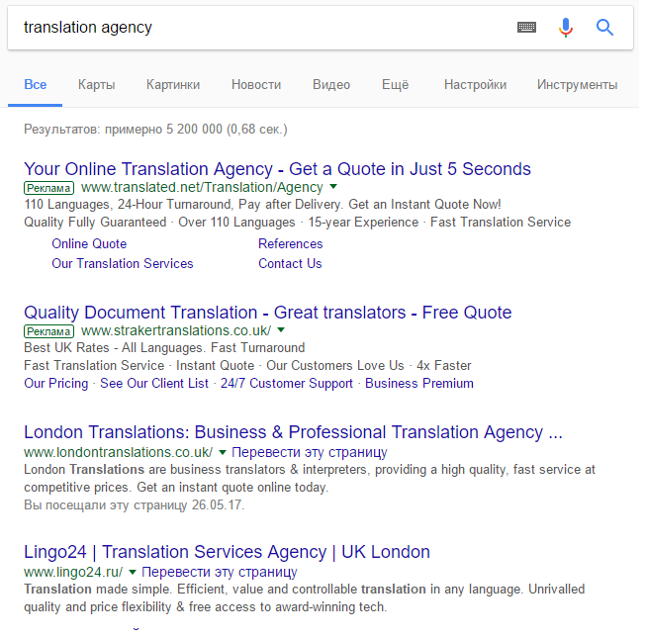
What search engines offer
AdWords (paid)
Organic (free of charge)

Slide 7
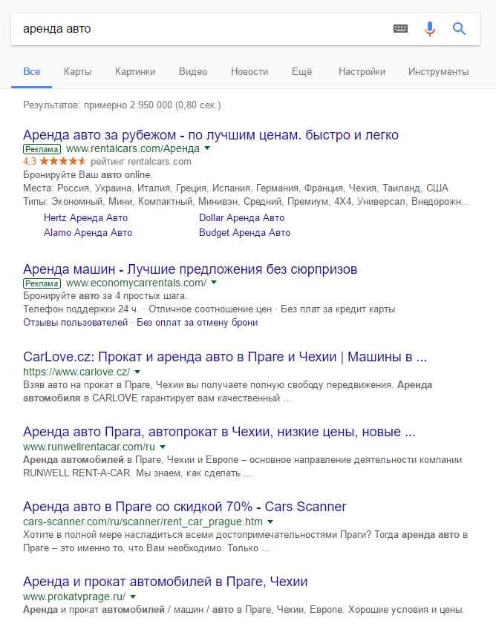
Organic cons and pros
Cons
low customer acquisition costs
confident users
a lot of traffic
long lasting result
Pros
high competition
a lot of bouncers
long time to wait
can’t understand anything

Slide 8
Step by step trying to understand
Keywords exploring
Generate landing pages
Create texts
Target a region
Getting links
User behavior
Commercial
Mobile friendly
Results

Slide 9
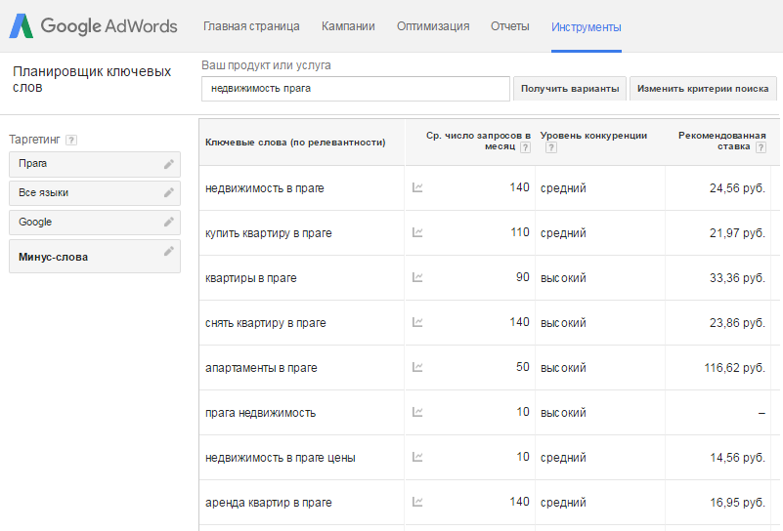
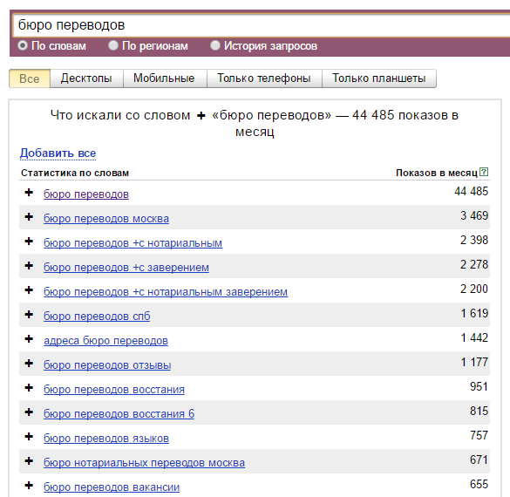
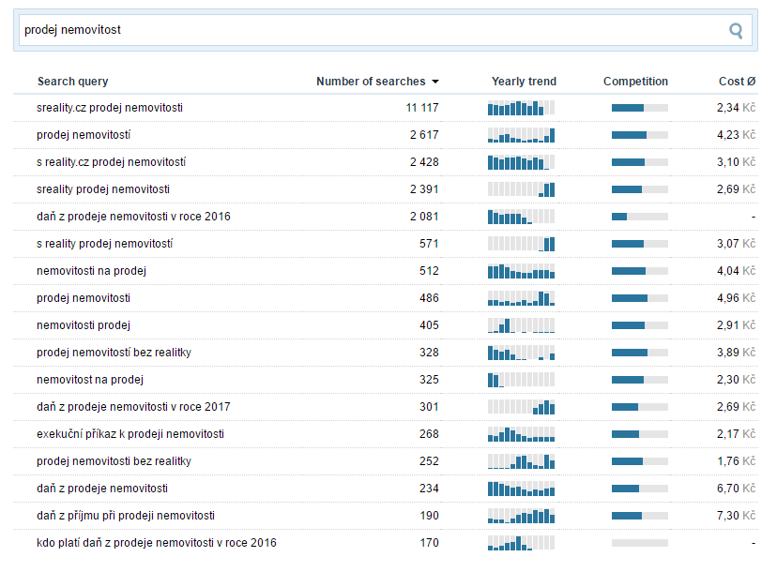
1. How to explore keywords
Google: adwords.google.com/o/KeywordTool
Seznam: sklik.cz/vytvoreni-kampane
Yandex: wordstat.yandex.ru

Slide 10
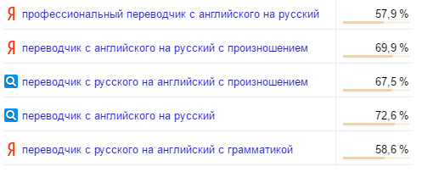
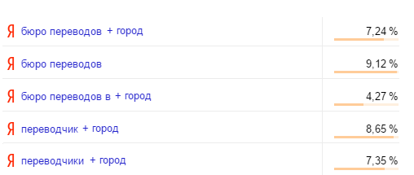
Right & wrong keywords
> 50% bounce rate
(wrong: online, spelling, professional)
< 10% bounce rate
(right: translation agency, * + region)

Slide 11
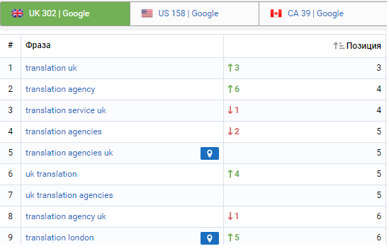
Competitors exploring
serpstat.com
semrush.com
ru.megaindex.com

Slide 12
2. Generate landing pages
Main page translation agency, translation company, translation service + region
Chinese — Spanish translate from chinese to spainsh uk
English — Russian перевести с английского на русский москва
Русский — Арабский Alanya'da Arapça Türkiye'de Rusçadan tercüme
About us
Contacts
Privacy

Slide 13
3. Create texts
Texts with keywords!
Usual natural language
Includes toponyms, synonyms
Unique
Paragraphs and headers
Media: photo, video, tables, links
Call to action

Slide 14
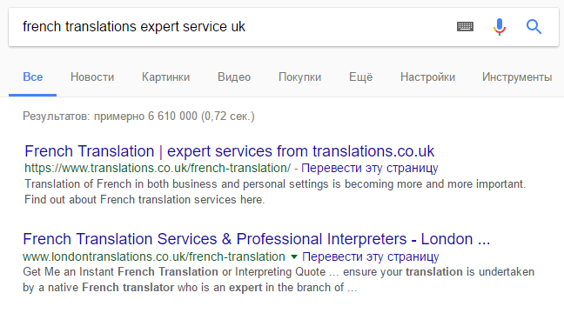
Titles with keywords

Slide 15
4. How to target to a region
Addresses in texts, region in titles
Country TLD (site.cz, site.de, site.es)
Local subdomain with national language
For multilingual: hreflang="ru“, hreflang= "es". How to
Google My Business
Google Search Console

Slide 16
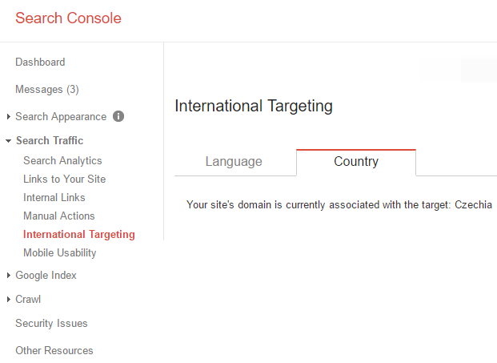
Google Search Console

Slide 17
5. How to get links
Inner links
Friends, dealers, suppliers
Local websites
Paid links
Crowd marketing
PBN
ahrefs.com

Slide 18
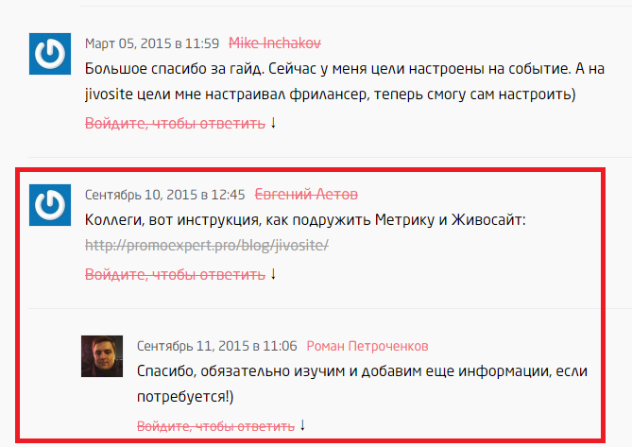
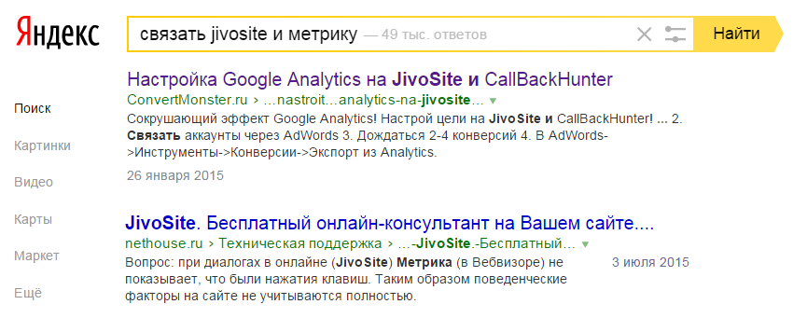
Crowd marketing
User — How to translate […]?
We — [relevant answer + links]

Slide 19
6. User behavior
Attention in SERP
Increase session duration

Slide 20
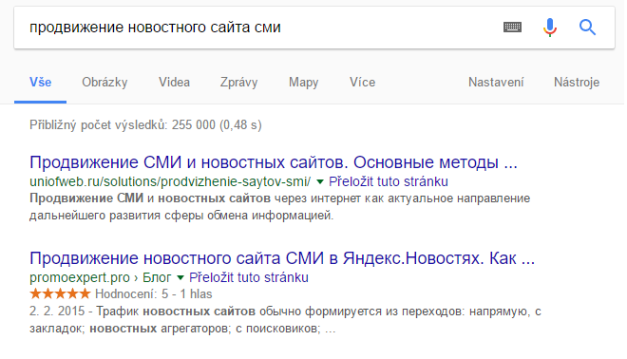
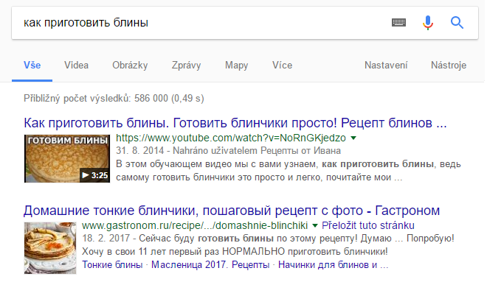
Attractive snippet
Keywords in texts and titles
Markup structured data

Slide 21
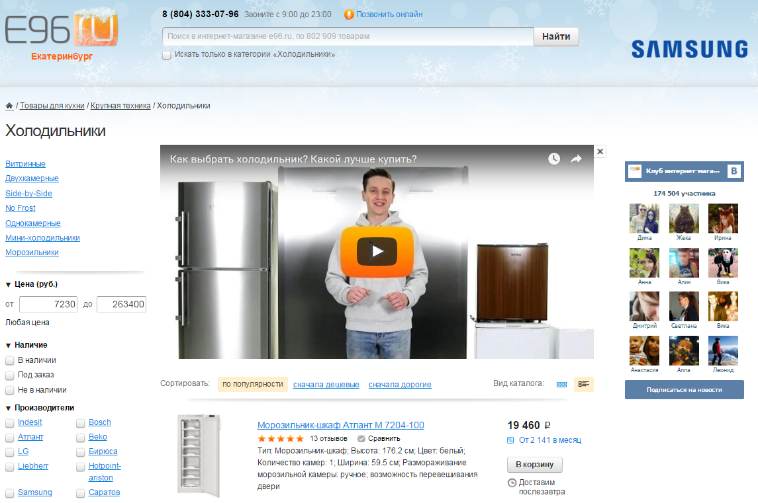
Increase session duration
Video, polls, sliders, Service calculator

Slide 22
7. Commercial checklist
Prices
Contact page with addresses and phones
Names and photos of translators
Another contact info (skype, whatsapp, facebook)
goo.gl/qhysQy

Slide 23
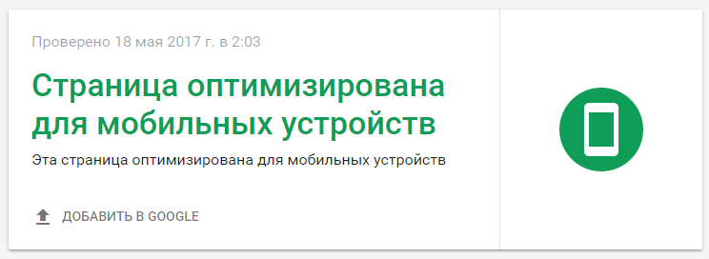
8. Mobile friendly test
https://search.google.com/search-console/mobile-friendly

Slide 24
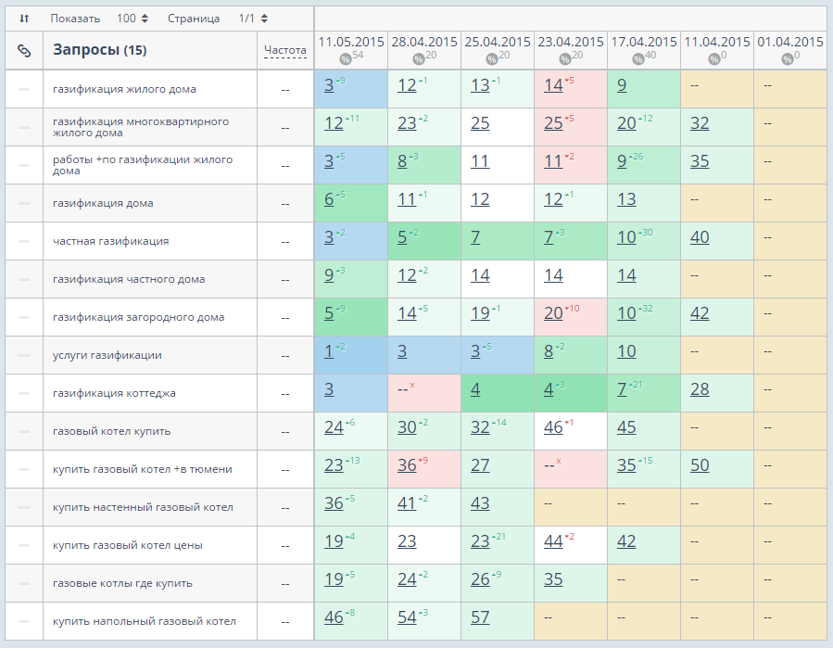
9. Results checking
topvisor.ru
seolib.ru
allpositions.ru
seobudget.ru (Seznam)
serpstat.com

Slide 25
10. Too hard?
Cons
very quick
confident users
pay only for clicks
clear budget
any country
Pros
very high competition
pay only for clicks

Slide 26
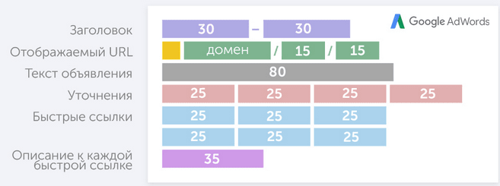
How to get cheap and be attractive
Relevant keywords in ads’ texts
Sales, Discount, Bonuses, Free
Purchase terms
Numbers
Punctuation symbols, letters case, %
Call to action

Slide 27
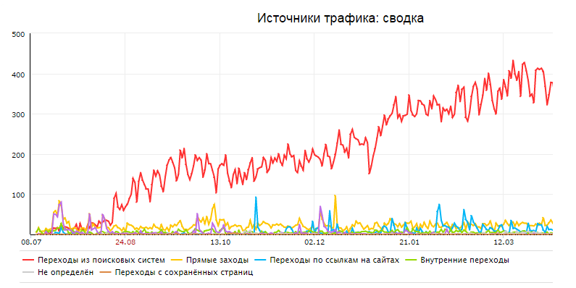
Traffic check

Slide 28
Now, it’s clear, why you are here
Let’s:
promote website by youself
control your employee or outsourcer
choose an agency

Slide 29
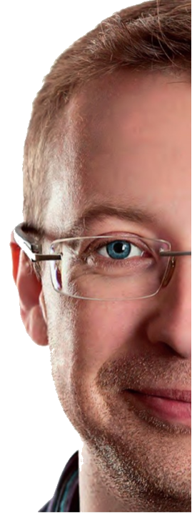
“We be one blood, thou and I”
seo checklist
Eugene Letov → fb.com/letov.e

