Slide 1
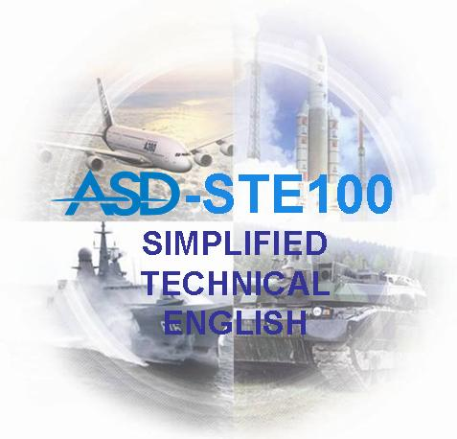
Celebrating 30 YEARS of STE (1986 – 2016)
Technical writing
and
Translation in
Simplified Technical English
Orlando Chiarello
Over 100 Years of History
AND AEROSPACE TECHNOLOGY
Astrakhan, July 1, 2016

Slide 2
Simplified Technical English
Purpose of the presentation
Raise awareness, especially for technical writers and translators, that STE exists
Explain the reasons why this “controlled language” was created
Give a short overview of the STE basic principles, rules, and structure
Explain why an STE document uses restricted grammar rules / wording and differs from a document written in standard “everyday English”
Give information on where to find STE material
Give information about STE certified training
Give information on how to use STE in technical writing and translation
Introduce potential future steps towards localized versions in other languages (from STE into other languages)

Slide 3
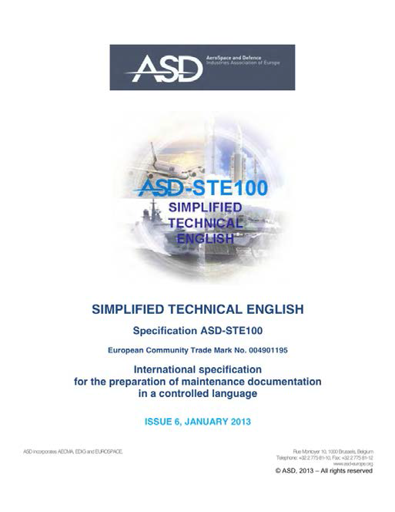
Simplified Technical English
Presentation overview
About the presenter
What is ASD Simplified Technical English (STE)?
Short history
Why a controlled language for aviation?
How do you use STE?
Who is STE for?
How is STE maintained?
How do you learn to use STE?
STE and translation
Summary and information

Slide 4
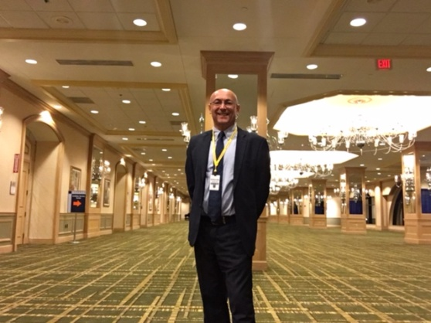
Simplified Technical English
The presenter
Orlando Chiarello
Product Support Manager of Secondo Mona S.p.A.
Former technical translator and technical writer
Chairman of the ASD Simplified Technical English Maintenance Group (STEMG) and AIAD-Italy national delegate
Member of the ASD Product Services Specification Group
Member of the AIAD-Italy Documentation Working Group
STE tutor at Uninettuno University

Slide 5
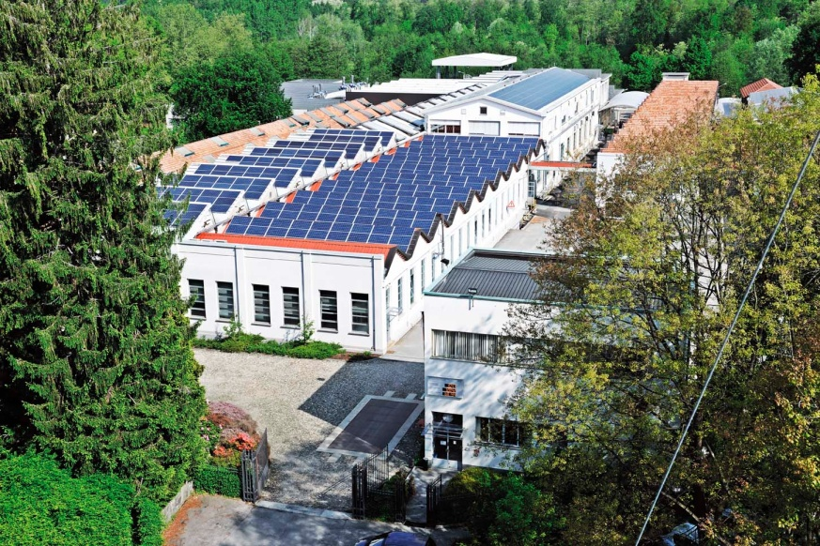
Simplified Technical English
Secondo Mona S.p.A.
An Italian aerospace company, privately owned, employing around 260 people in its factory and offices in Somma Lombardo, close to Milan-Malpensa International Airport.
Founded in 1903 by Mr. Secondo Mona for the sale and repair of cycles and motorcycles, in 1913 it started supplying the aerospace industry with MRO activities for the first aero-engines and since 1923 it designs and produces its own equipment for aircraft, mainly in fuel.
Today, Secondo Mona is a qualified and experienced partner in the global aerospace and defense market for the supply of on-board equipment and systems.
The products designed and developed by Secondo Mona have been selected by European companies for more than half a century and in the last decade also by both American and Asian Customers.

Slide 6
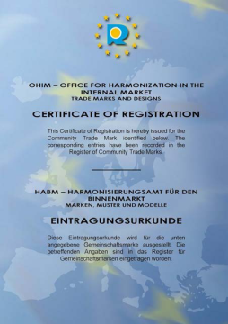
Simplified Technical English
ASD
The AeroSpace and Defence Industries Association of Europe
(formerly AECMA), Rue Montoyer 10, Brussels, Belgium
ASD is the owner of the STE specification
STE (ASD-STE100) - Simplified Technical English
International specification for preparation
of technical documentation in
a controlled language

Slide 7
Simplified Technical English
Short history of STE
In the late 1970s, the Association of European Airlines (AEA) asked the European Association of Aerospace Industries (AECMA) to investigate the readability of maintenance documentation in the civil aircraft industry and find a solution to standardize the language used to write such documentation.
AECMA asked the Aerospace Industries Association (AIA) of America to assist in this project. Two project groups from AECMA and AIA were formed.
These two groups explored the existing controlled languages and researched texts in maintenance manuals.
The AECMA Simplified English Working Group was founded and the AECMA Simplified English Project started in 1983.

Slide 8
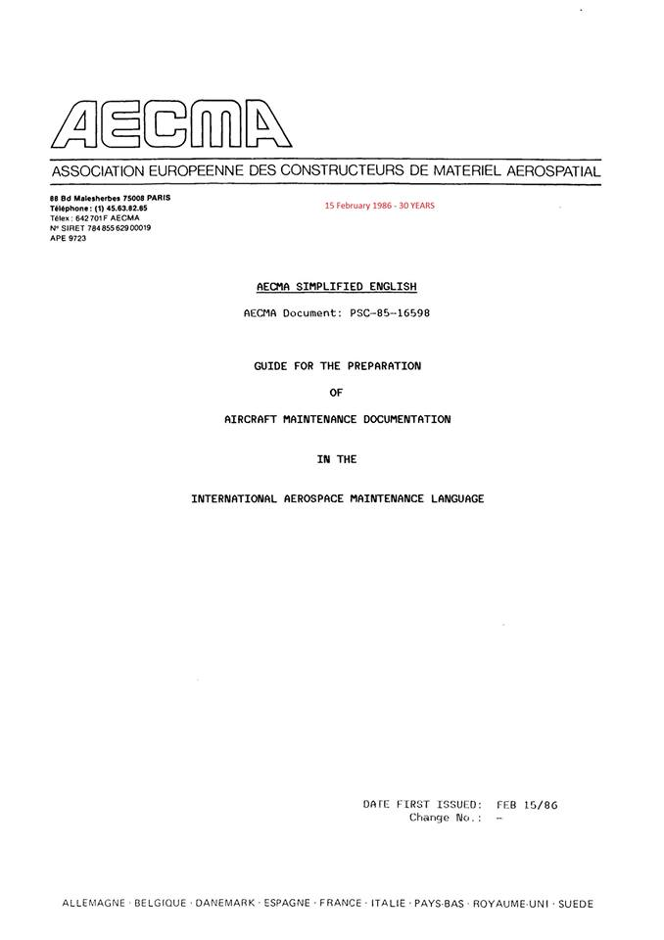
Simplified Technical English
Short history of STE
The product of this effort was the AECMA Simplified English Guide (first release in 1986) which at a subsequent stage (2005) became the ASD Simplified Technical English Specification.

Slide 9
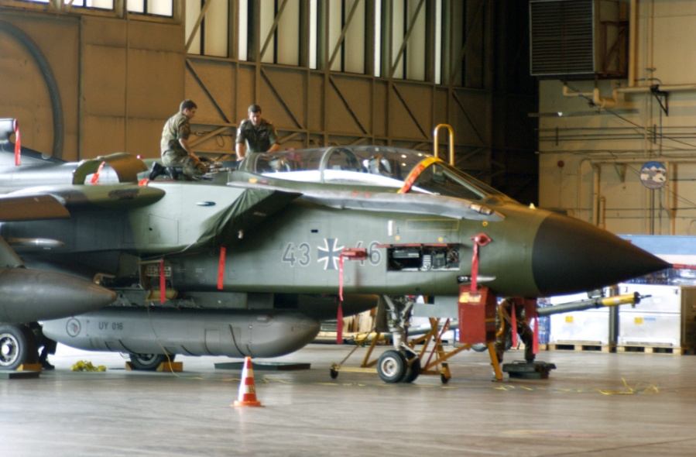
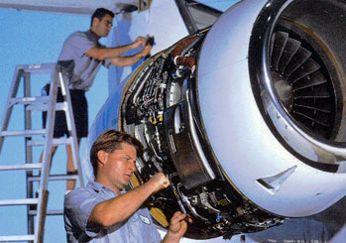
Simplified Technical English
Why a controlled language for aviation?
There are several reasons, when we consider what has happened in aviation, over the last 100 years.

Slide 10
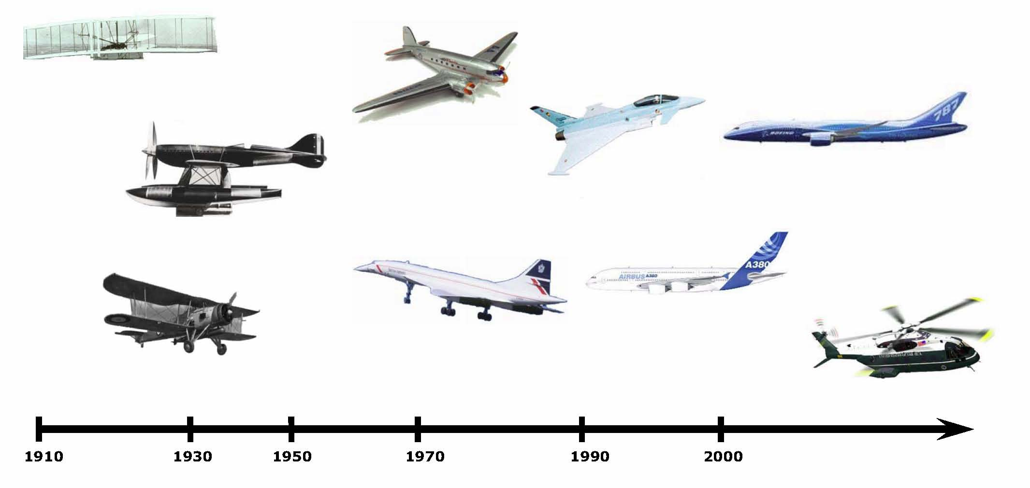
Simplified Technical English
The increasing complexity of air vehicles

Slide 11
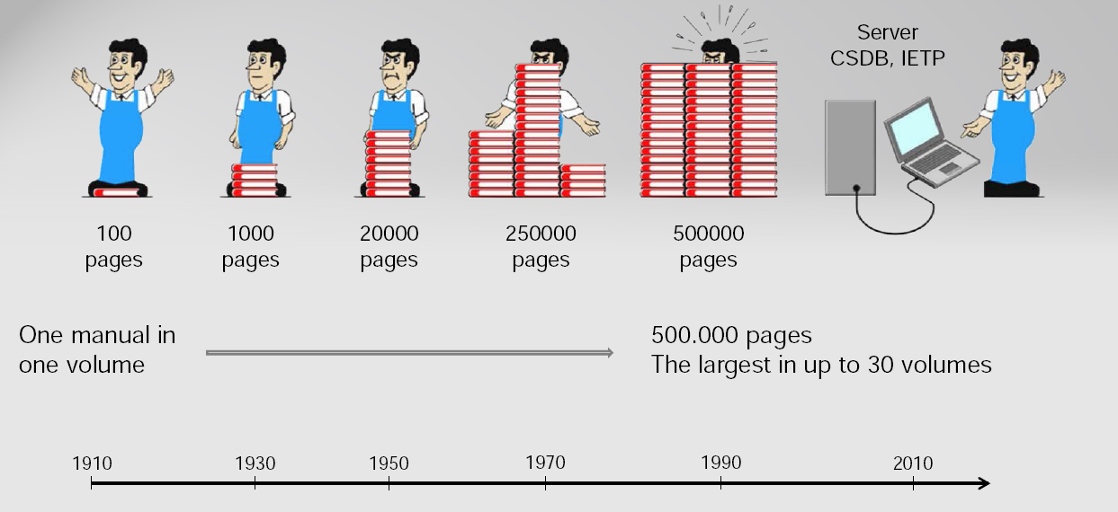
Simplified Technical English
The increasing complexity of documentation and data

Slide 12
Simplified Technical English
The increasing number of readers (the users)
who are non-native English speakers

Slide 13
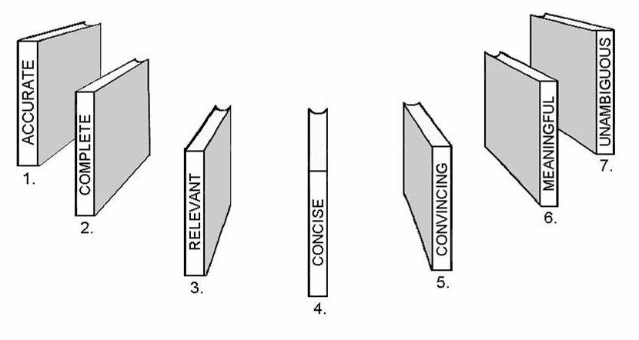
Simplified Technical English
The information / data that must be:
ACCURATE = conforming to a standard with total accuracy
COMPLETE = having all necessary information
RELEVANT = having connection with the subject
CONCISE = express much in few words
CONVINCING = causing to believe the truth
MEANINGFUL = having a meaning for the purpose
UNAMBIGUOUS = causing no doubts and leading to only one conclusion

Slide 14
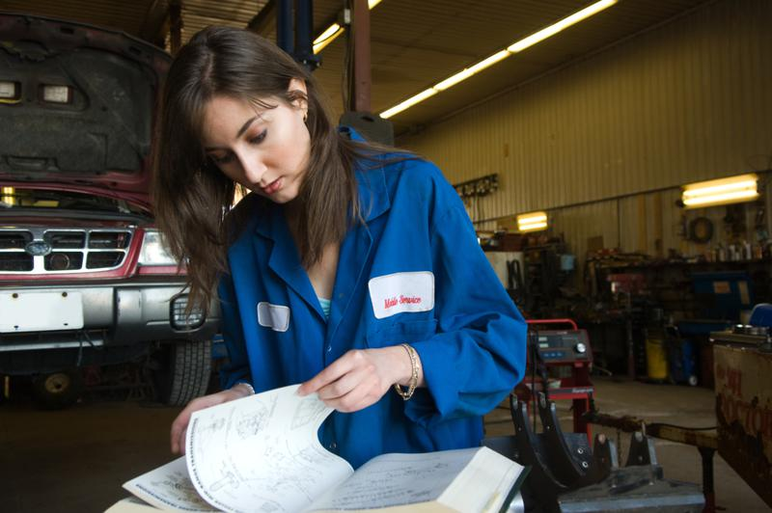
Simplified Technical English
A standard became necessary
A standard having:
A reduced number of words
Words with defined meanings
Words with defined parts of speech
A simplified grammar structure
for the maximum benefit of the users!

Slide 15
Simplified Technical English
The ASD-STE100 specification
How it is used
Part 1: Writing rules
(65 rules in 9 Sections)
Part 2: Dictionary
(869 approved words)
Latest issue is 6 – January 2013
The specification is available at no cost

Slide 16
Simplified Technical English
PART 1 – Writing rules
Section 1 – Words
Section 2 – Noun clusters
Section 3 – Verbs
Section 4 - Sentences
Section 5 – Procedures
Section 6 – Descriptive writings
Section 7 – Warnings, cautions, and notes
Section 8 – Punctuation and word count
Section 9 – Writing practices

Slide 17
Simplified Technical English
PART 1 – STE primary writing rules
The basic principle of STE is to keep texts
as simple and readable as possible
Use words that are:
Approved in the dictionary (controlled)
Technical names (19 categories, not controlled, not listed in the dictionary)
Technical verbs (4 categories, not controlled, not listed in the dictionary).
Use approved words from the dictionary only as the part of speech given.
Use approved words only with their approved meanings.
Use only the approved forms of verbs and adjectives.
Write noun clusters of no more than three words.
When applicable, put the article or a demonstrative adjective before nouns.
Only use the active voice in procedural writing. Use the active voice as much as possible in descriptive writing.
Only use the “-ing” form of a verb as a modifier in a technical name.

Slide 18
Simplified Technical English
PART 1 – STE primary writing rules
Be clear and specific.
Use vertical lists for complex text.
Write short sentences (a maximum of 20 words for procedures, 25 for descriptive text).
Write only one instruction in each sentence.
Write instructions in the imperative (command) form.
Present information gradually.
Use paragraphs to show related information.
Make sure that each paragraph has only one topic.
Make sure that a paragraph has no more than six sentences.
Use safety words (warning or caution) to identify the level of risk.
Write notes only to give information, not commands.
Use a “different construction” to rewrite sentences when a “word-for-word” replacement is not sufficient.

Slide 19
Simplified Technical English
Approved meaning
PART 2 - Dictionary
KEYWORD (part of speech) | Approved meaning / ALTERNATIVE | APPROVED EXAMPLE | Not approved example
INJURY (n) | Damage to a person | BEND THE ENDS OF THE LOCKING WIRE TO PREVENT INJURY.
INNER (adj) | Nearer to the center (TN) of an object | THE INNER SURFACE OF THE PART IS BLACK.
inoperative (adj) | OFF, NOT OPERATE (v) | MAKE SURE THAT THE SYSTEM IS OFF BEFORE YOU DRAIN THE FUEL. | Make sure the system is inoperative before you drain the fuel.
 |  | MAKE SURE THAT THE DEMISTING SYSTEM DOES NOT OPERATE. | Ensure demisting system is inoperative.
Approved keyword
Not approved keyword
Suggested alternatives

Slide 20
Simplified Technical English
Basic principles of STE
STE is a set of writing rules and a dictionary of controlled vocabulary
The primary purpose of STE is to make technical texts easy to understand by all readers
STE is an adaptable and flexible resource for writing accuracy
The STE controlled general vocabulary has sufficient words to write all technical sentences
In addition to this general vocabulary, STE permits the unrestricted use of words that are ‘technical names’ and ‘technical verbs’
Essentially…
Authors can use the STE dictionary as a “core” and add technical names and technical verbs that are applicable to their companies, their projects, and industries

Slide 21
Simplified Technical English
Examples of rewriting
Non-STE: If damage has been noted, return the engine to the repair shop with details of rectifications required.
STE: If you find damage, send the engine back to the repair shop with instructions for the necessary repairs.
STE: If there is damage, send the engine back….
Non-STE: When securing mainshaft in clamps do not damage protective finish on mainshaft.
STE: When you attach the mainshaft to the clamps, do not cause damage to the protective layer on the mainshaft.
STE: When you hold the mainshaft in the clamps, do not cause damage to the protective layer on the mainshaft.

Slide 22
Simplified Technical English
Examples of rewriting
Position a gasket on the right-hand outlet of the diffuser case; locate the tube, together with the support bracket for the inlet tube of the bearing air cooler, to the outlet. Secure tube and bracket to the outlet with the four bolts; torque-tighten bolts.
1. Put a gasket on the right outlet of the diffuser case.
2. Put the tube, and the support bracket for the inlet tube of the bearing air cooler, in the outlet.
3. Attach the tube and the bracket to the outlet with the four bolts.
4. Torque each of the four bolts to 4 Nm.

Slide 23
Simplified Technical English
Who uses STE?
STE was designed and developed for the aviation industry , but:
58% of the STE users are now outside aerospace and defense
Copies of the latest Issue 6 (January 2013) have been requested by:
More than 200 universities worldwide
Leading companies in various sectors of industries

Slide 24
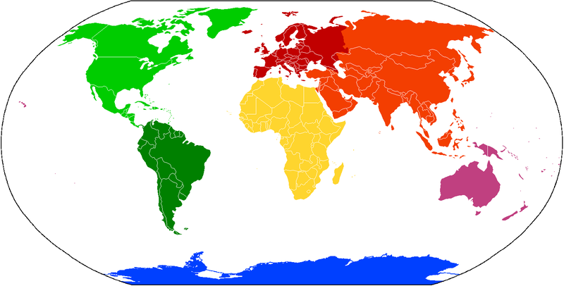
Simplified Technical English
Who uses STE?
To date, almost 4000 copies of Issue 6 distributed in 85 different countries!!!
CONTINENT | %
Europe | 51%
North America | 29%
Asia (and the Middle East) | 12%
South America | 5%
Pacific | 3%
Africa | 1%
TOTAL | 100%
Top 10 countries
COUNTRY | %
USA | 25%
United Kingdom | 11%
Germany | 11%
France | 4%
Italy | 4%
Canada | 4%
Sweden | 4%
India | 4%
Argentina | 3%
The Netherlands | 3%

Slide 25
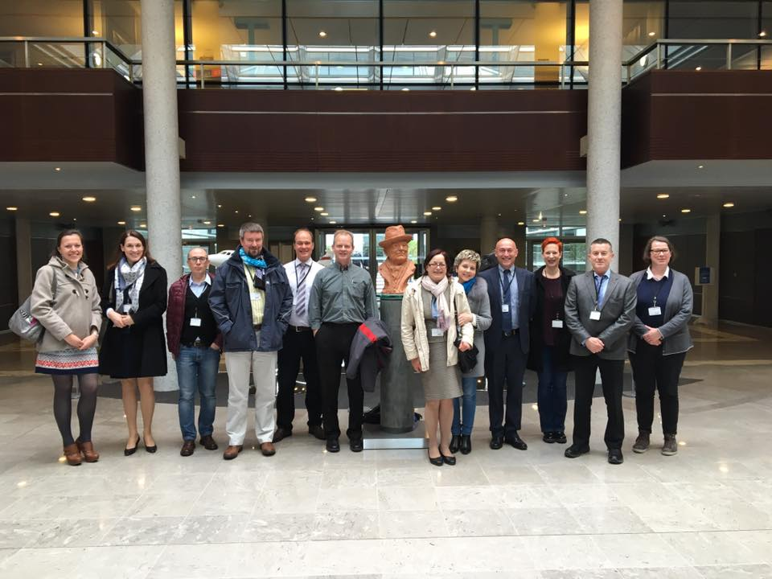
Simplified Technical English
The Simplified Technical English Maintenance Group (STEMG)
STE is maintained by the ASD STEMG, a non-profit group, consisting of representatives from ASD member countries and non-ASD member countries.
The STEMG is a well-balanced group of professionals having technical and linguistic background of experience.
To keep STE up to date and to improve it as necessary.
To process change requests, take the appropriate amendment actions, and release new issues of the specification as and when required.
To provide advice and recommendations to STE users.
To promote STE in general

Slide 26
The Simplified Technical English Maintenance Group (STEMG)
Simplified Technical English

Slide 27
Simplified Technical English
How you learn to use STE
Author’s side
Requisites
Good writing skills
Good command of written English
Good technical know-how and knowledge of the matter being treated
Steps
Careful study of the specification (writing rules)
Writing practices (necessary to master the controlled vocabulary)

Slide 28
Simplified Technical English
How you learn to use STE
Author’s side
Training
Members of the STEMG are authorized trainers (traditional classrooms)
In November 2013, ASD and the International University UNINETTUNO, Rome, signed an Agreement for certified STE training (online platform)
Authoring tools
Some software products and authoring tools (syntax and grammar checkers, term checkers, etc.) that support STE are available on the market. Software tools will not think in author’s place and will not write STE texts for them!
ASD and the STEMG do not endorse authoring tools
Users do not necessarily have to learn STE. They receive a text that is easy to read, fully understandable and, above all, technically correct!

Slide 29
Simplified Technical English
How to prepare a document in STE?
There are no fixed rule or schemes
Skill and competence of the author is a key factor
The STE author should be able to:
Write a new text directly in STE
Convert existing texts from standard English into STE
The author MUST always have the reader in mind (!)
A familiarization training is recommended
Authoring tools can help but the author MUST always have the last word on its text

Slide 30
Simplified Technical English
STE and translation
When STE was created, one of the primary objectives was to help translation
The STE translator should be able to:
Translate a text written in another language into STE
Translate a text written in STE into another language
The latter is a challenge indeed and can result in future steps of localized versions of STE in other languages (Simplified Technical Spanish, German, Russian, Italian, etc.)
A remarkable past attempt was the GIFAS Rationalized French where the principles and rules of STE were transferred into the French language
A very significant recent project is the Español Técnico Simplificado developed as a “mirror language” of STE
Some new projects in this direction have been launched, others are under development

Slide 31
Simplified Technical English
STE and translation
While STE accuracy of software products is not guaranteed, software may be useful in building up the customized terminology of technical names and technical verbs
They can also associate the STE approved words with the approved equivalent in other languages, so facilitating the automation of the translation process
This does not guarantee 100% accuracy. Again, the author MUST always have the last word on its translated text. But even 90% accuracy would be an exceptional result

Slide 32
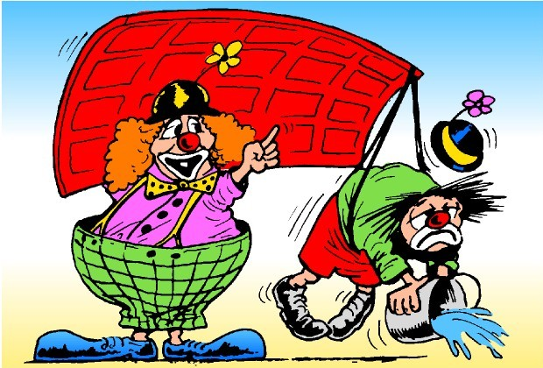
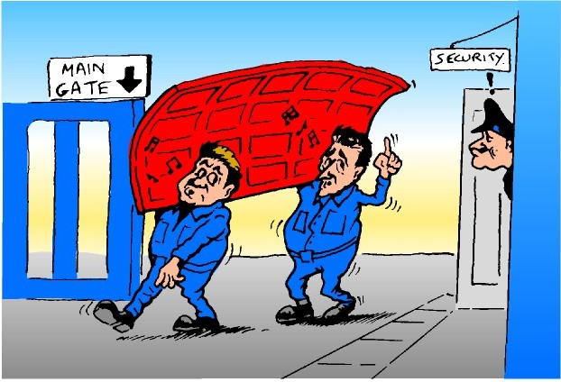
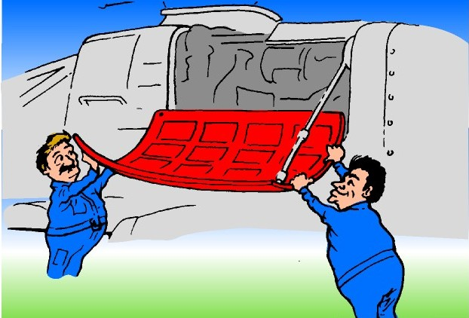
Simplified Technical English
Towards the ….. conclusion
Remember, in STE: one word = one meaning! YOU…
Do not perform the task
Do not carry out the task
Do not undertake the task
DO the task !

Slide 33
Simplified Technical English
The role of STE in communication
STE gives a common code to be shared among people
The STE vocabulary is restricted to 879 approved words
STE shows you how to use the approved words
Each word has a defined meaning
Each word has a defined part of speech
STE gives the rules that help you write clearly
STE helps to remove language problems where English is not the native language
STE helps the translation of English texts into other languages
STE helps the Machine Translation process
“With STE we may, at last, be on the threshold of making English logical and tidy.” (The Times)

Slide 34
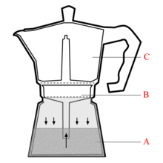
Simplified Technical English
The moka pot
Description in STE
The moka pot, also known as the "caffettiera" or the “macchinetta”, is a coffee maker device. It has the function to make coffee with pressurized water.
The caffettiera has three primary parts:
- The bottom chamber (A)
- The filter (B)
- The collecting chamber (C).
To make coffee, it is necessary to put water in the bottom chamber (A) and ground coffee in the filter (B). The collecting chamber (B) is tightened on the threads of the bottom chamber (A) and a gasket prevents leakage from the assembled parts.
When the caffettiera is on the burner, the water temperature increases. The vapor in the boiler expands and pressurizes the water surface. The pressure pushes the mass of the water down and then the water will be pushed up through the filter funnel (A to B). When the water goes up, it goes also through the ground coffee in the filter (B) and thus brews the coffee. The brewed coffee through the pipe will gradually fill the collecting chamber (C).
At the end of the process, only air and vapor move from the bottom chamber (A) to the collective chamber (C). The water level in the bottom chamber (A) will be the same as the level at the filter and the funnel. The remaining water in the boiler will prevent overheating. A safety relief valve, installed in the bottom chamber (A), prevents an overpressure condition and operates if there is a blockage.

Slide 35
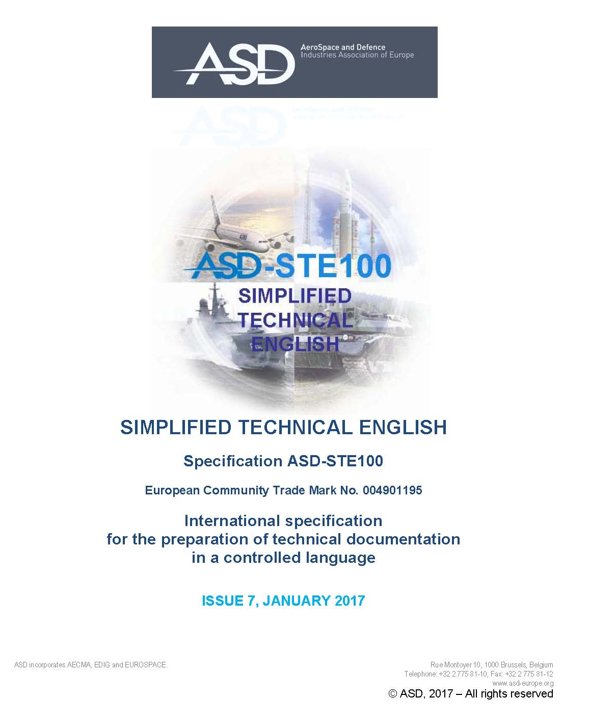
Simplified Technical English
The new ISSUE 7
is under final review
IT WILL BE AVAILABLE
IN JANUARY 2017
NEW SIGNIFICANT IMPROVEMENTS AND SIMPLIFICATIONS

Slide 36
Simplified Technical English
THANK YOU FOR YOUR ATTENTION!
“If you simplify your English, you are freed from the worst follies of orthodoxy… ....
And when you make a stupid remark, its stupidity will be obvious, even to yourself.”
George Orwell (1946) - Politics and the English Language.
More information?
Please visit: www.asd-ste100.org
Please contact: info@asd-ste100.org
Please visit the STEMG Facebook page
Follow the STEMG on Twitter @asd_stemg
Get in contact with the STEMG on Linkedin
Request a free copy of STE www.asd-ste100.org
Orlando Chiarello orlando.chiarello@secondomona.com

